Slide 1


German Census
Final Report
Andrei Staradubets
Bai Li
Erblina Jakupi
Priya Arumugam

Slide 2
Contents
Introduction to our dataset - German Census 2011
Processing
Clustering
Prediction

Slide 3

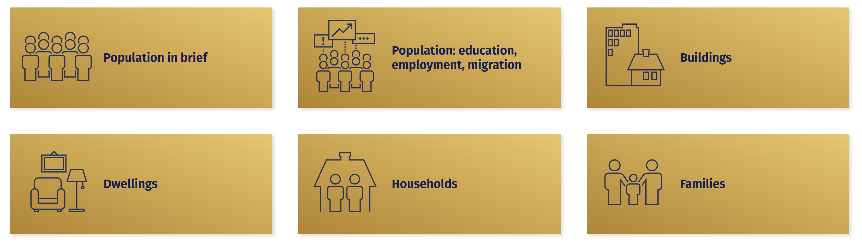
Introduction to German Census 2011
How does our dataset look like?
Data from 2011
Include 6 Themes
Notes:
Dataset is German census 2011.
This dataset describes the information of different aspects of German general social situation.
German government
It includes 6 themes: population in brief, population with different education, employment migration background. Buildings. Dwellings. Household and Families.
From these 6 themes we can find that our dataset has the data from population, buildings and the higher level data as family.

Slide 4
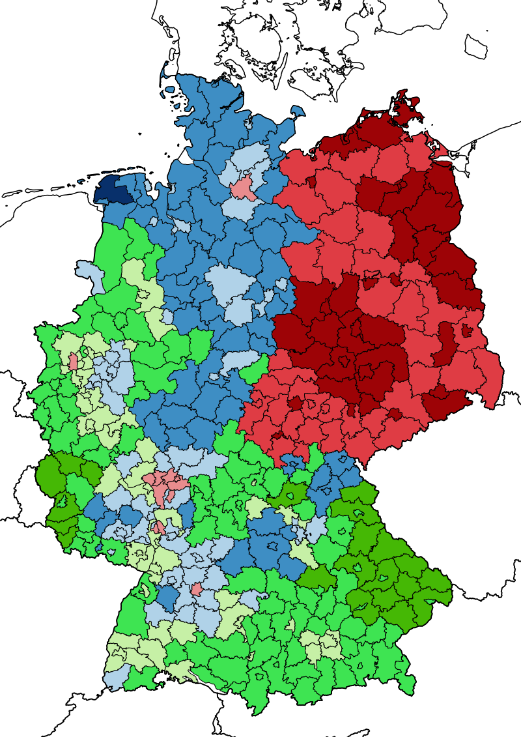
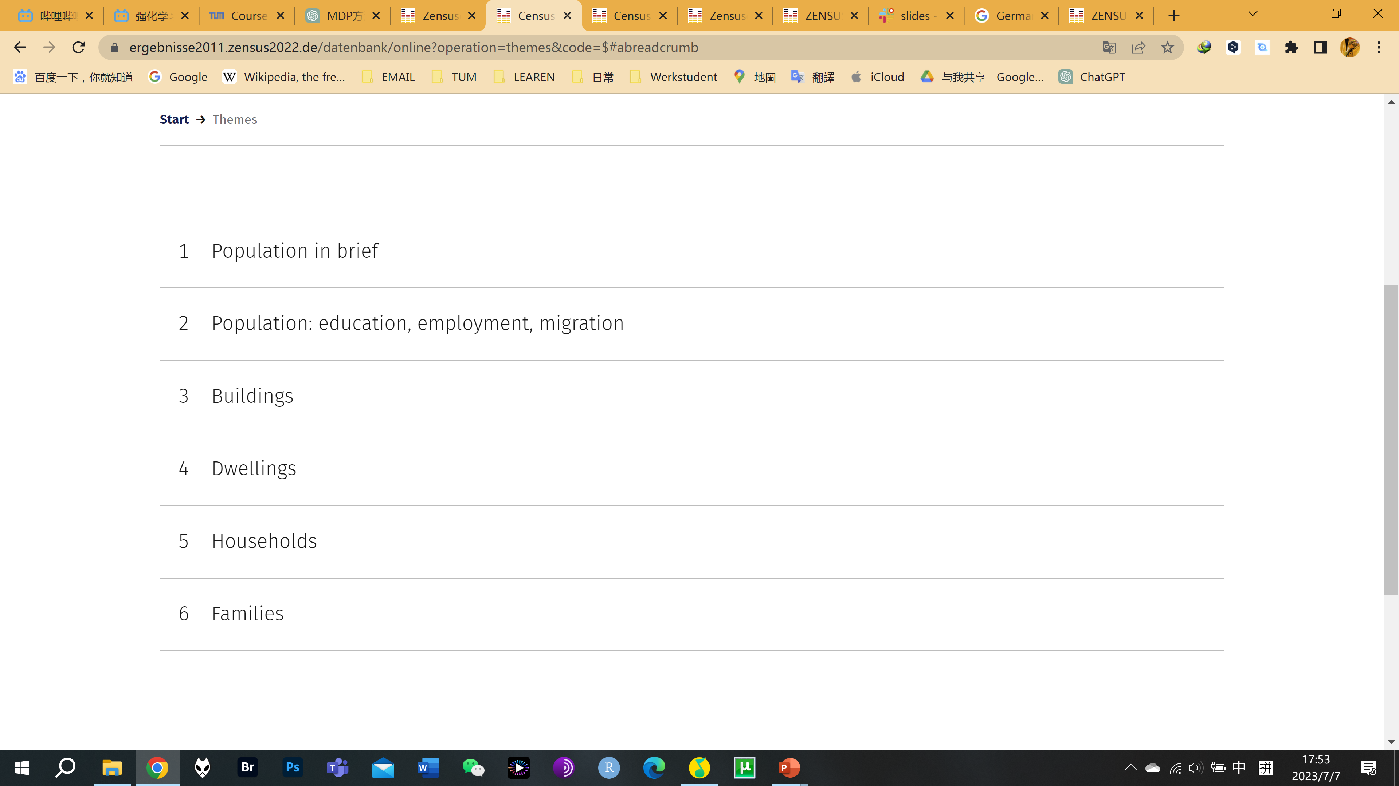
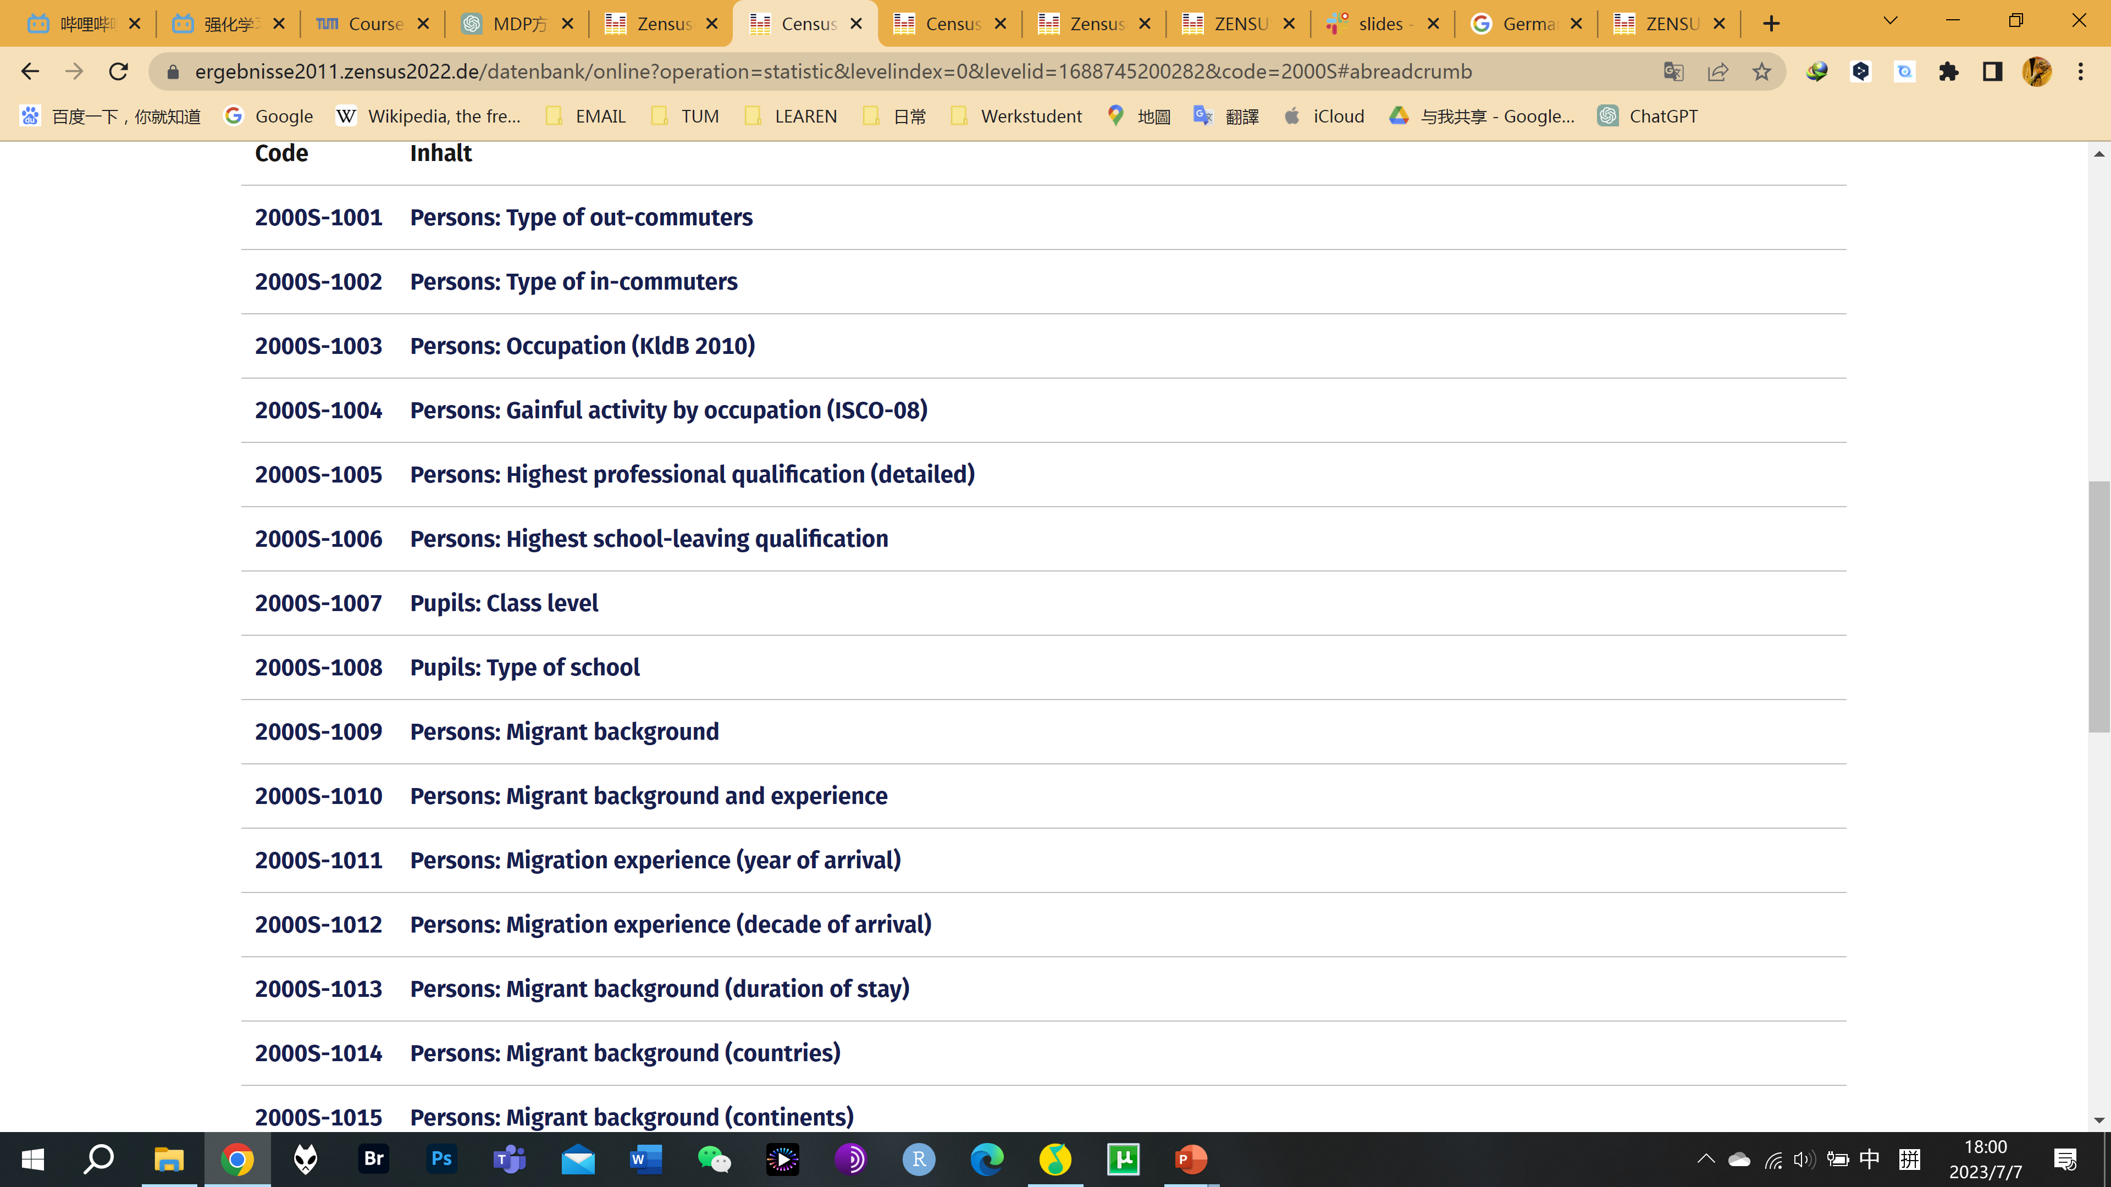
Introduction to German Census 2011
How does our dataset look like? – Structure of dataset
412 Districts
(412 Data points)
6 Themes
Features in Subsets

Slide 5
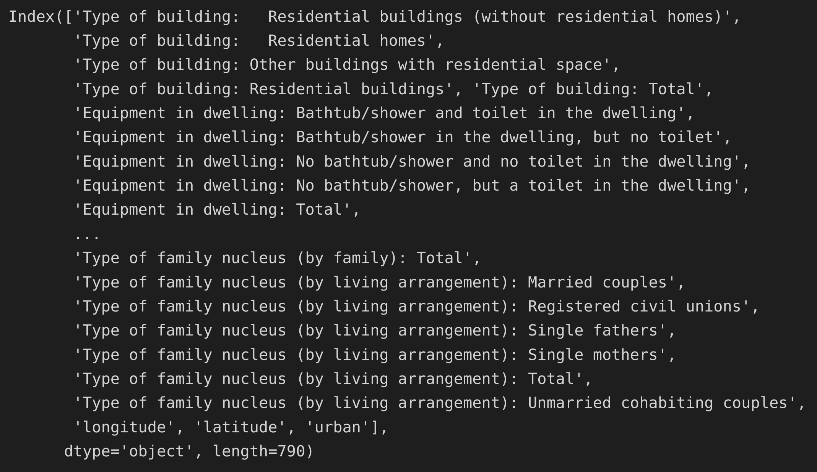
Introduction to German Census 2011
Merge subsets to create the final dataset. – 412 districts with 23 subsets but not a tidy dataset
412 Districts
789 Subsets Features
3 Aspects:
Building
Population
Family
……

Slide 6






Introduction to German Census 2011
What estimation want to predict?
Building
What is type and years of buildings in these districts?
Type: Urban or Country
Is this district urban or country?
District location
Is this district in east/west
Germany?
Employ and education
Age Trend
What is the age trend in different districts?
Migrant
What is the relationship between migrant and other features?

Slide 7
Processing

Slide 8
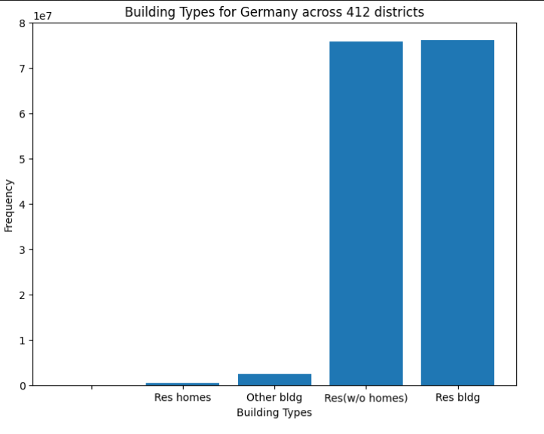
Processing
Data Feature Selection
Feature Selection
Overall 752 features with 6th main focus.
Dropped the unnecessary features
Combination of Features
23 unique feature subsets
412 distinct

Slide 9
Processing
Correlation
For absolute values dataset top-100 features were highly correlated, for proportional dataset most features were not correlated.
Data distribution
Data quality check, Feature selection, Modeling Assumption Validation, Anomaly detection
Trend Charts

Slide 10
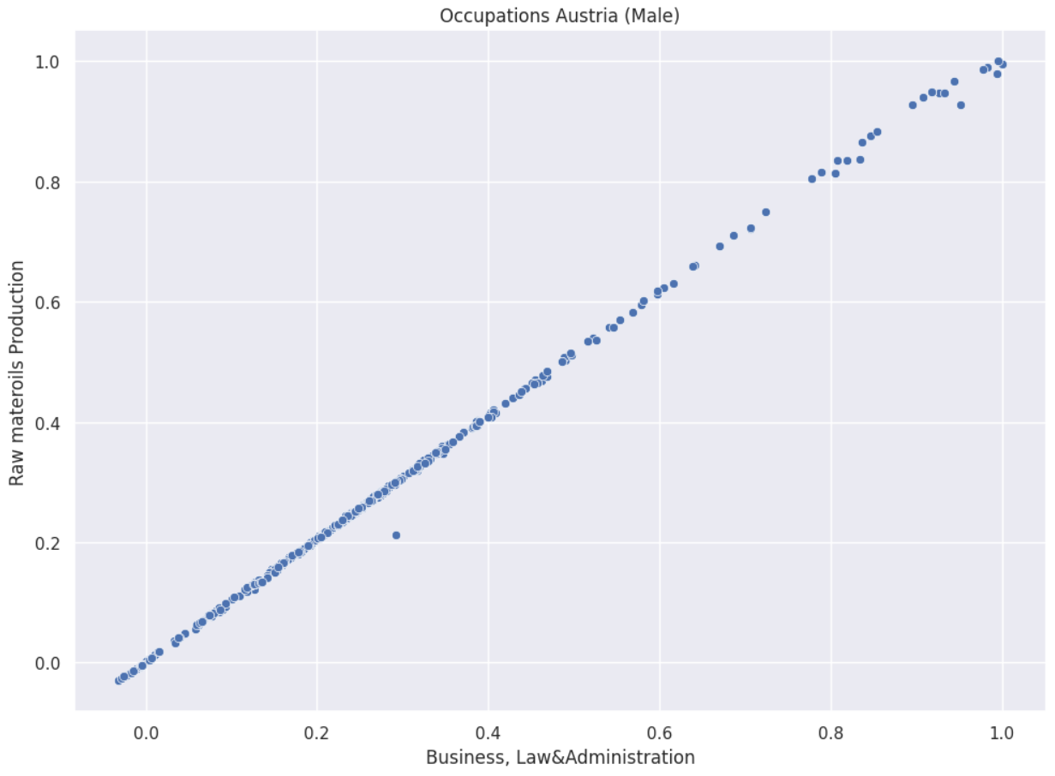
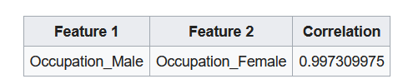
Processing – Correlation

Slide 11
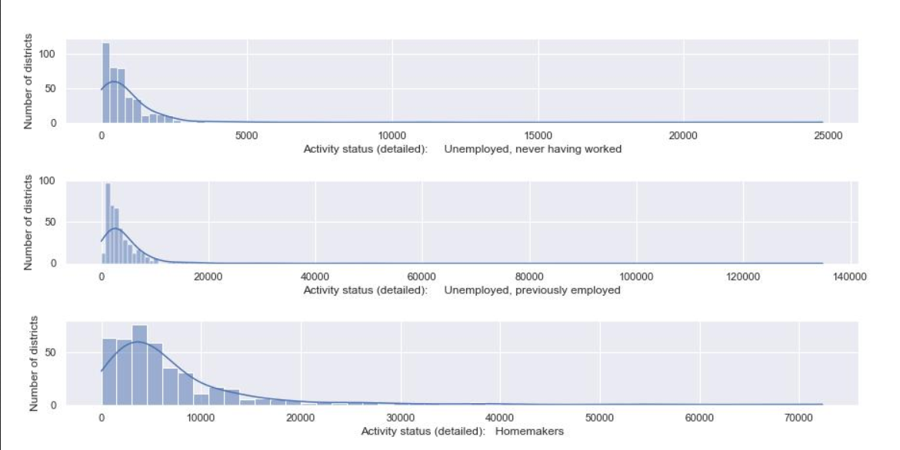
Processing – Data Distribution

Slide 12
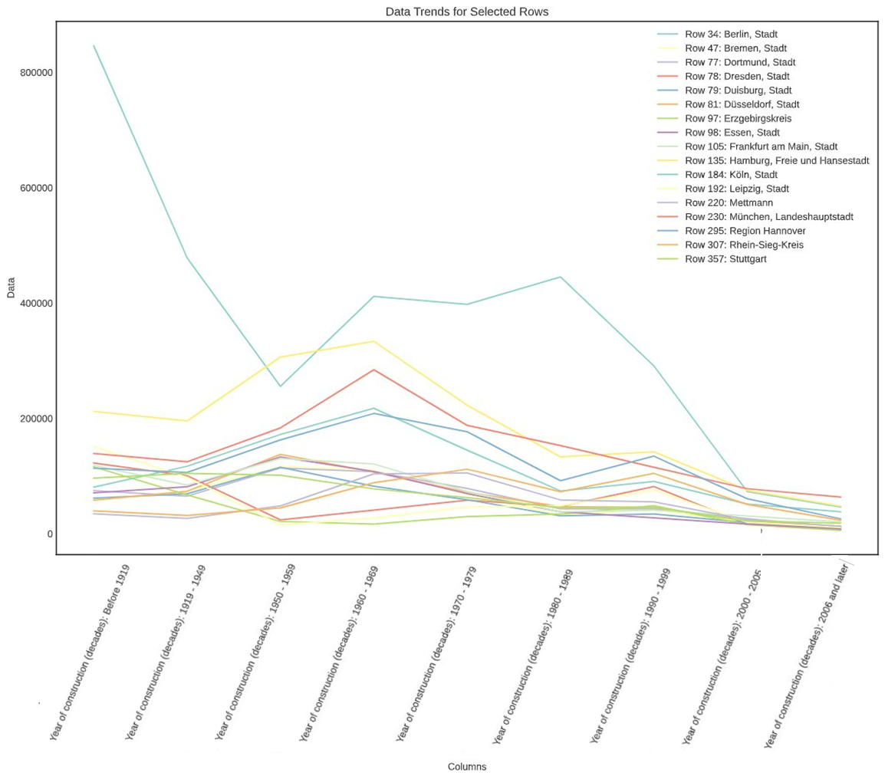
Processing
Trend Charts

Slide 13
Clustering

Slide 14
Clustering
Two types of dataset
AgglomerativeClustering
Analysis of clusters matching to real life concepts

Slide 15
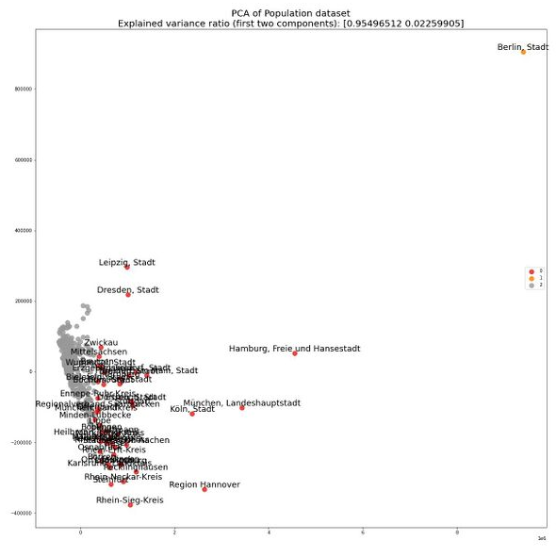
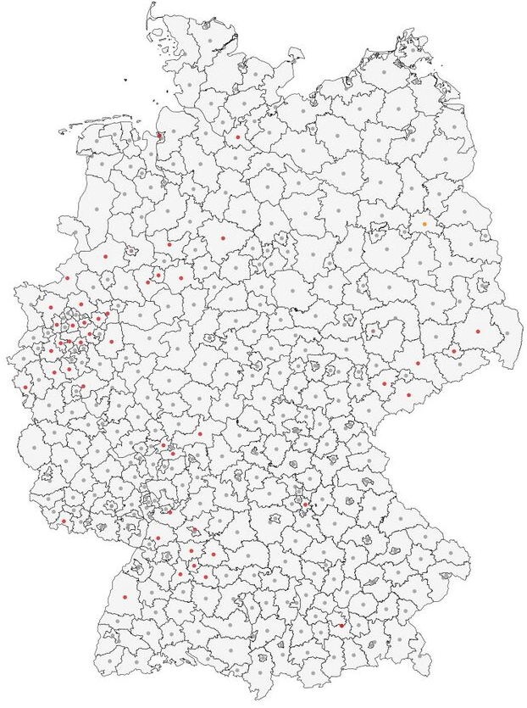
Clustering (Absolute Values)
15

Slide 16
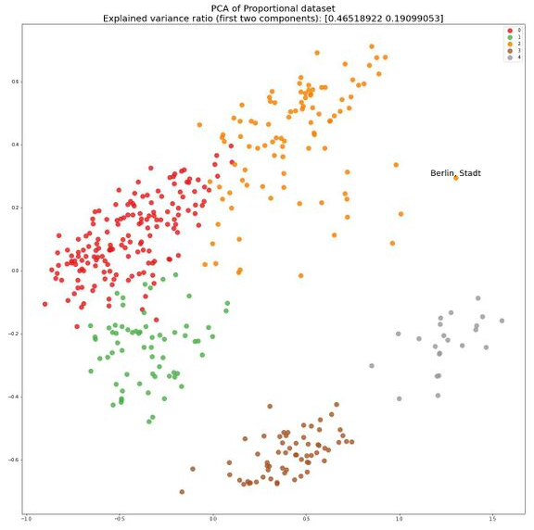
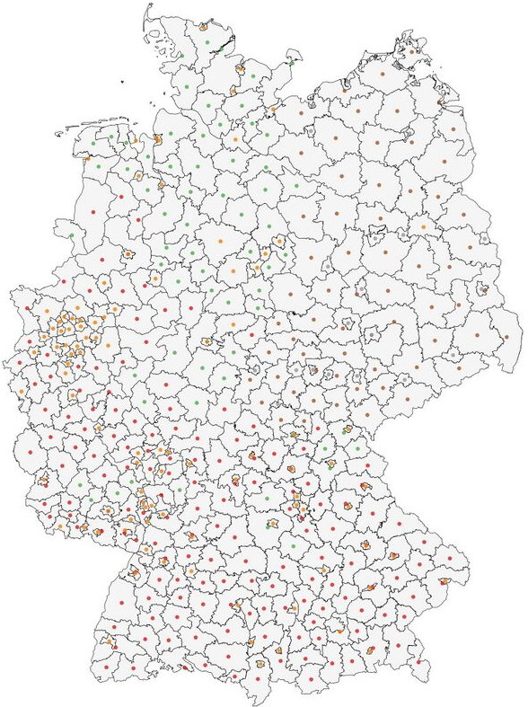
Clustering (Proportional Values)
16

Slide 17
Prediction

Slide 18
Prediction
Classification
North-South-East Classification
Urban-Rural
Regression
Construction trend after 2006
Migrant rate
University Degree holders
Divorced female between 25-29

Slide 19
Classification
Dataset choice
Forward feature selection
Comparison of algorithms (Logistic Regression, SVC, RidgeClassifier)
Hyper-parameter tuning
Results comparison based on dimensionality reduction and feature selection

Slide 20
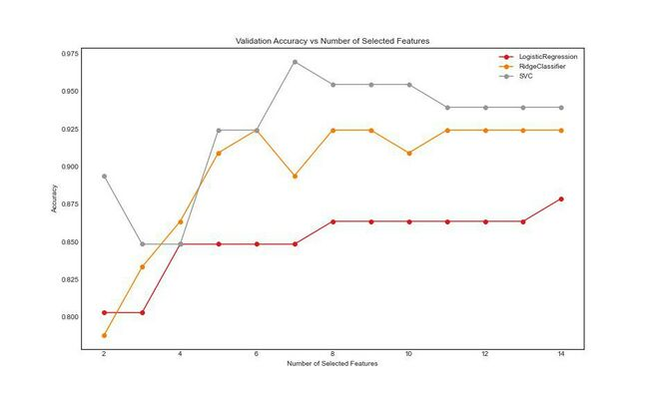
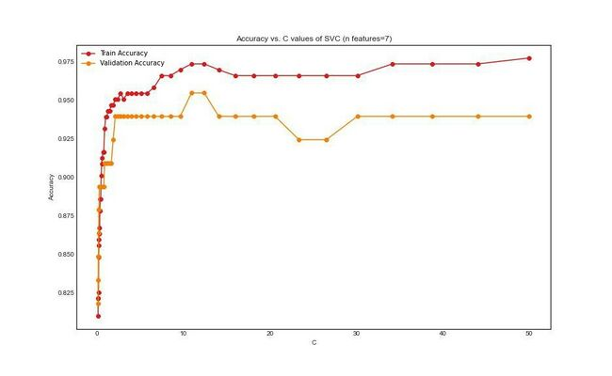
Results – N/S/E
Best C = 7.6
Train accuracy: 0.93
Val accuracy: 0.90
Test accuracy: 0.91

Slide 21
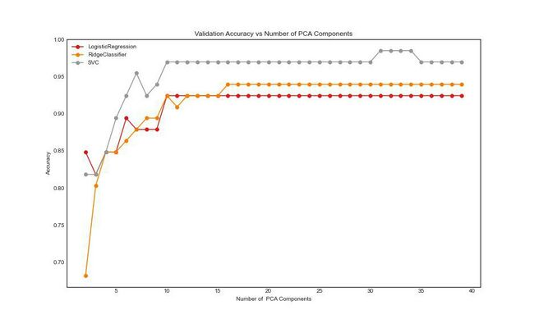
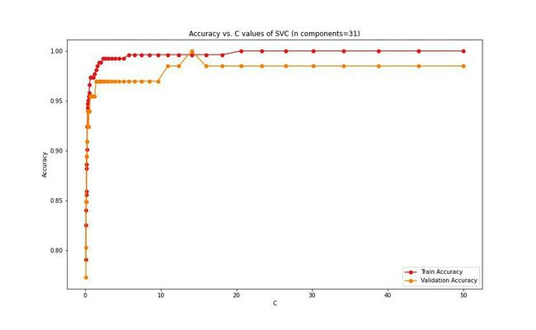
Results – U/R
Best C = 38.8
Train accuracy: 0.93
Val accuracy: 0.93
Test accuracy: 0.90

Slide 22
Regression
Dataset choice
Comparison of algorithms (Linear Regression, PCA, RidgeRegression)
Hyper-parameter tuning
Results comparison based

Slide 23
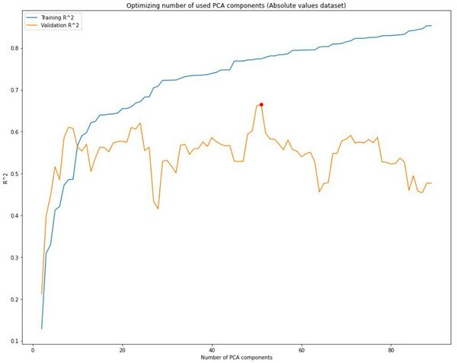
Results – Migrant Rate (Absolute Values)
R-Square Loss
Train – 0.76
Val – 0.63
Test – 0.62

Slide 24
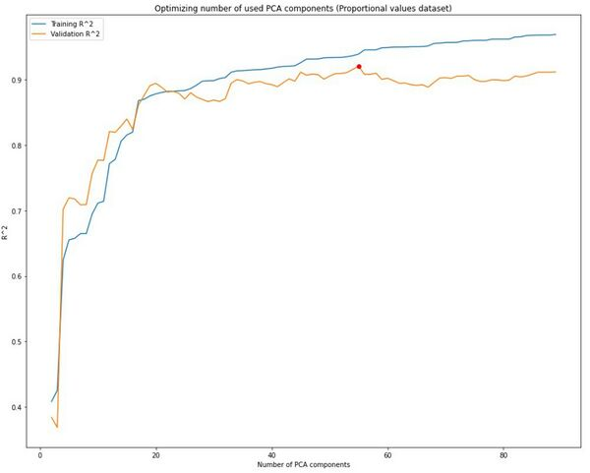
Results – Migrant Rate (Proportional Dataset)
R-Square Loss
Train – 0.93
Val – 0.92
Test – 0.89

Slide 25
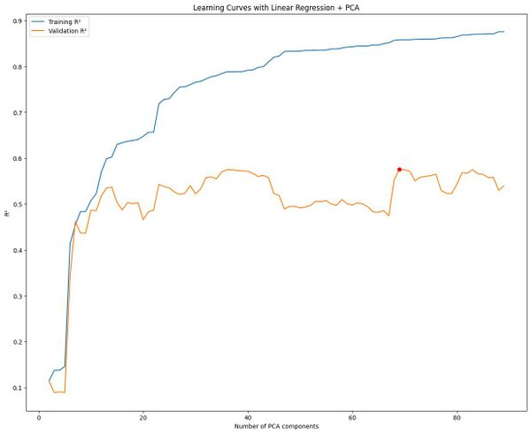
Results – Construction Trend
R-Square Loss
Train – 0.87
Val – 0.53
Test – 0.80

Slide 26
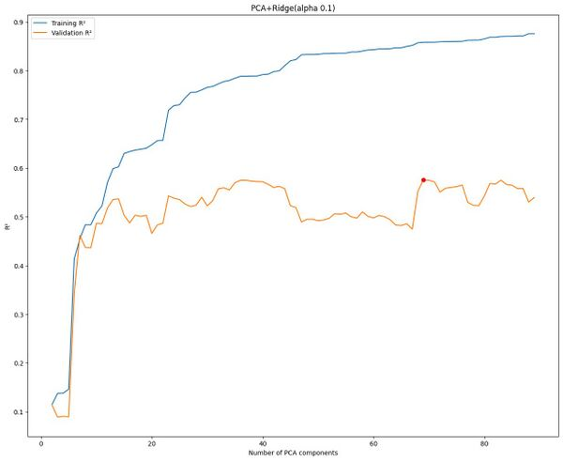
Results – Construction Trend
R-Square Loss
Train – 0.81
Val – 0.58
Test – 0.76

Slide 27
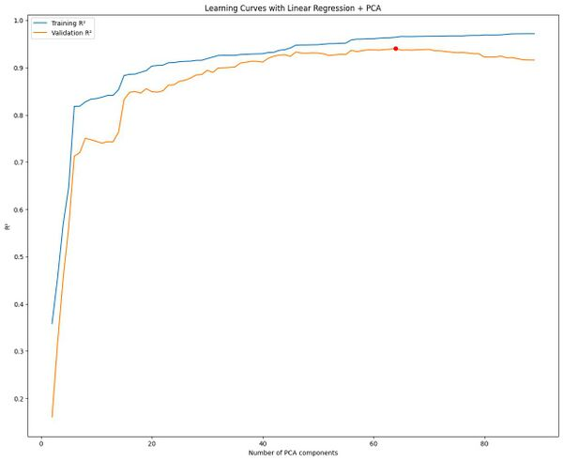
Results – University degree Holders
R-Square Loss
Train – 0.96
Val – 0.89
Test – 0.92

Slide 28
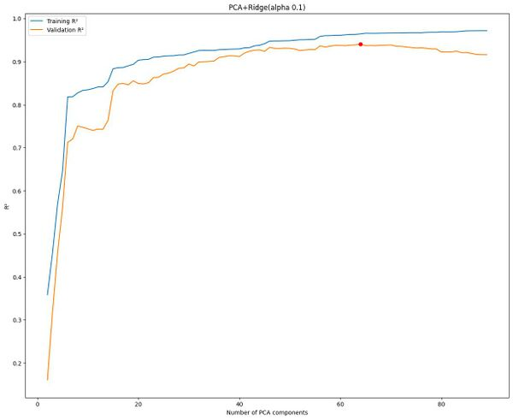
Results – University degree Holders
R-Square Loss
Train – 0.93
Val – 0.91
Test – 0.87

Slide 29
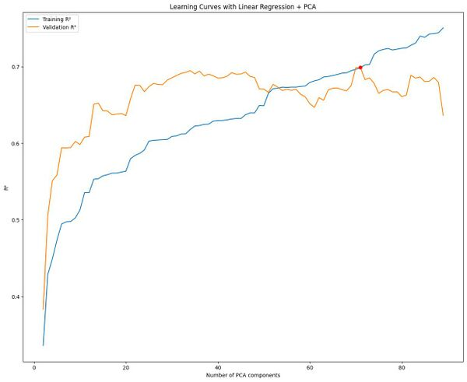
Results – Divorced Female
R-Square Loss
Train – 0.69
Val – 0.69
Test – 0.60

Slide 30
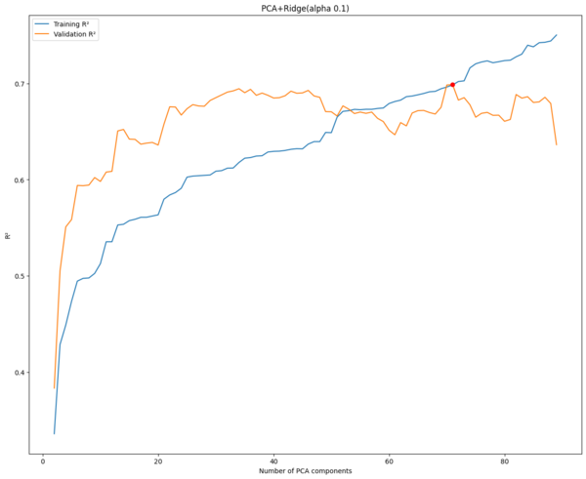
Results – Divorced Female
R-Square Loss
Train – 0.63
Val – 0.68
Test – 0.56

Slide 31
Conclusion

Slide 32
Thank you!
Any Questions?
German Census Team

